Slide 1
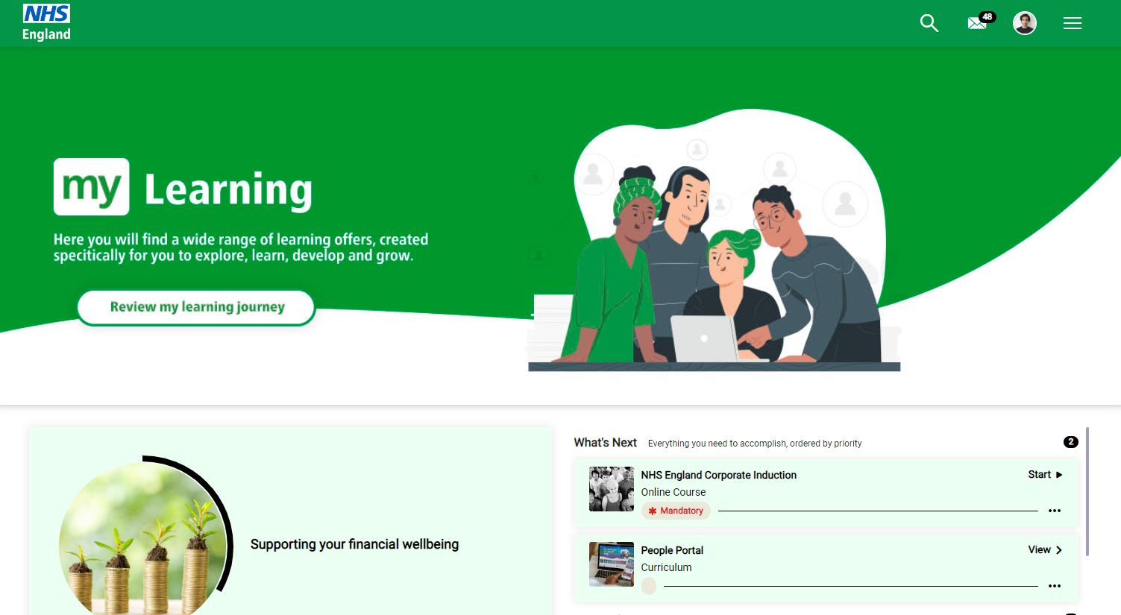
Able to add buttons on the welcome banner as well as text to help with accessibility
Request to remove the shadow under the welcome banner

Slide 2
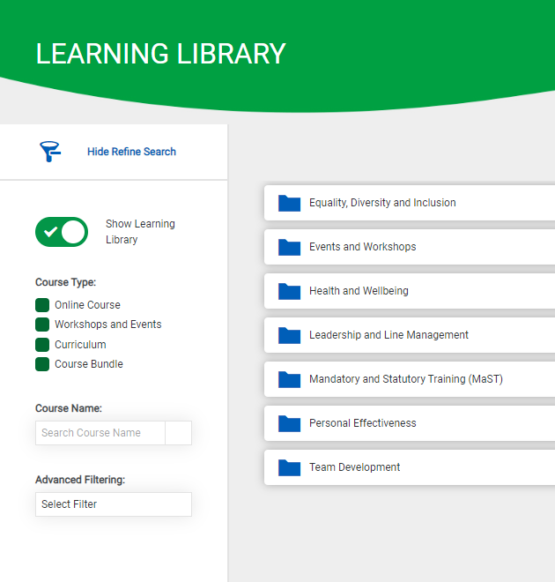
Pages which are Absorb engage related has white background
Standard pages have grey background

Slide 3
Make the tiles have round corners

Slide 4
Options to hide the footer or align the information at the bottom as the there is too much empty space when only adding quick links

Slide 5
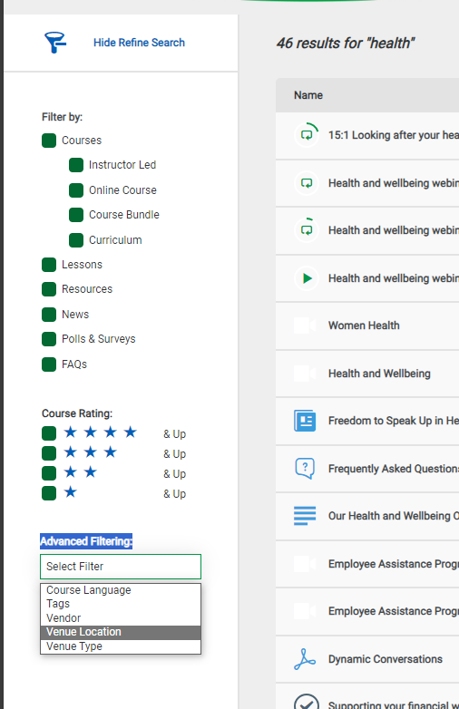
Options to hide filters as not all would be relevant to everyone.

Slide 6
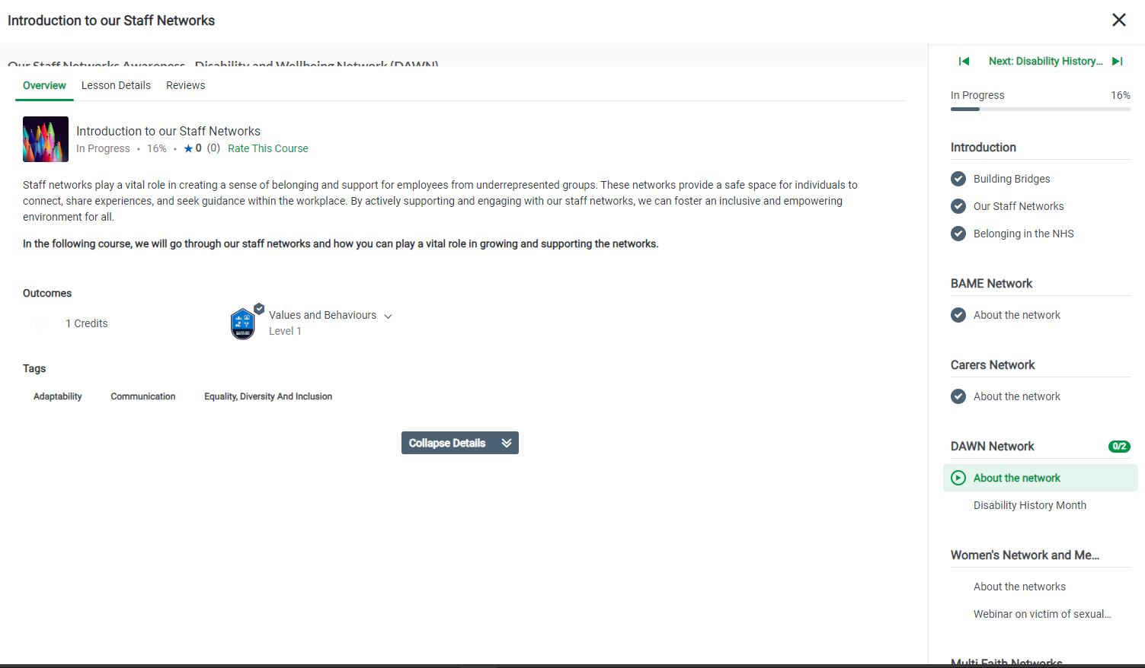
From our testing, the following button placement would be better larger.
User testing shows the colour of the whole bar will be better/visible in a different colour as it’s not clear if they part of a hidden collapse options

Slide 7
Having options to add navigation buttons or site map

